Slide 1
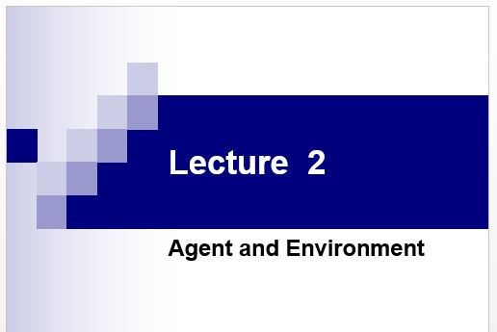

Slide 2
Today’s class
What’s an agent?
Definition of an agent
Rationality and autonomy
Types of agents
Properties of environments

Slide 3
How do you design an intelligent agent?
Definition: An intelligent agent perceives its environment via sensors and acts rationally upon that environment with its actuators.
A discrete agent receives percepts one at a time, and maps this percept sequence to a sequence of discrete actions.
Properties
Autonomous
Reactive to the environment
Pro-active (goal-directed)
Interacts with other agents via the environment

Slide 4
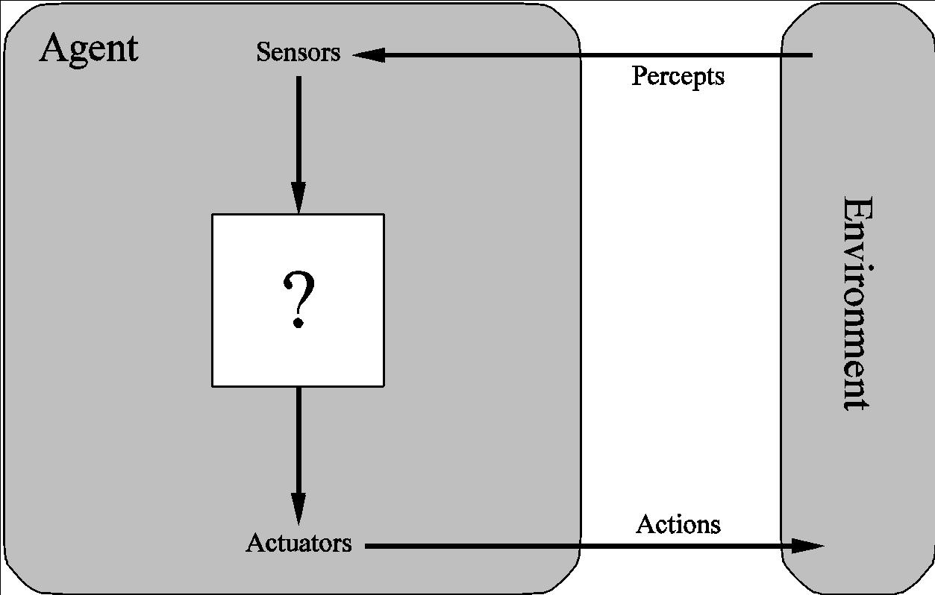
Agents
ITC364 Computational Intelligence
‹#›

Slide 5
What do you mean, sensors/percepts and actuators/actions?
Humans
Sensors: Eyes (vision), ears (hearing), skin (touch), tongue (gustation), nose (olfaction), neuromuscular system (proprioception)
Percepts:
At the lowest level – electrical signals from these sensors
After preprocessing – objects in the visual field (location, textures, colors, …), auditory streams (pitch, loudness, direction), …
Actuators: limbs, digits, eyes, tongue, …
Actions: lift a finger, turn left, walk, run, carry an object, …
The Point: percepts and actions need to be carefully defined, possibly at different levels of abstraction

Slide 6
A more specific example: Automated taxi driving system
Percepts: Video, sonar, speedometer, odometer, engine sensors, keyboard input, microphone, GPS, …
Actions: Steer, accelerate, brake, horn, speak/display, …
Goals: Maintain safety, reach destination, maximize profits (fuel, tire wear), obey laws, provide passenger comfort, …
Environment: Urban streets, freeways, traffic, pedestrians, weather, customers, …
Different aspects of driving may require different types of agent programs!

Slide 7
Rationality
An ideal rational agent should, for each possible percept sequence, do whatever actions will maximize its expected performance measure based on
(1) the percept sequence, and
(2) its built-in and acquired knowledge.
Rationality includes information gathering, not “rational ignorance.” (If you don’t know something, find out!)
Rationality → Need a performance measure to say how well a task has been achieved.
Types of performance measures: false alarm (false positive) and false dismissal (false negative) rates, speed, resources required, effect on environment, etc.

Slide 8
Autonomy
A system is autonomous to the extent that its own behavior is determined by its own experience.
Therefore, a system is not autonomous if it is guided by its designer according to a priori decisions.
To survive, agents must have:
Enough built-in knowledge to survive.
The ability to learn.

Slide 9
Some agent types
Table-driven agents
use a percept sequence/action table in memory to find the next action. They are implemented by a (large) lookup table.
Simple reflex agents
are based on condition-action rules, implemented with an appropriate production system. They are stateless devices which do not have memory of past world states.
Agents with memory
have internal state, which is used to keep track of past states of the world.
Agents with goals
are agents that, in addition to state information, have goal information that describes desirable situations. Agents of this kind take future events into consideration.
Utility-based agents
base their decisions on classic axiomatic utility theory in order to act rationally.

Slide 10
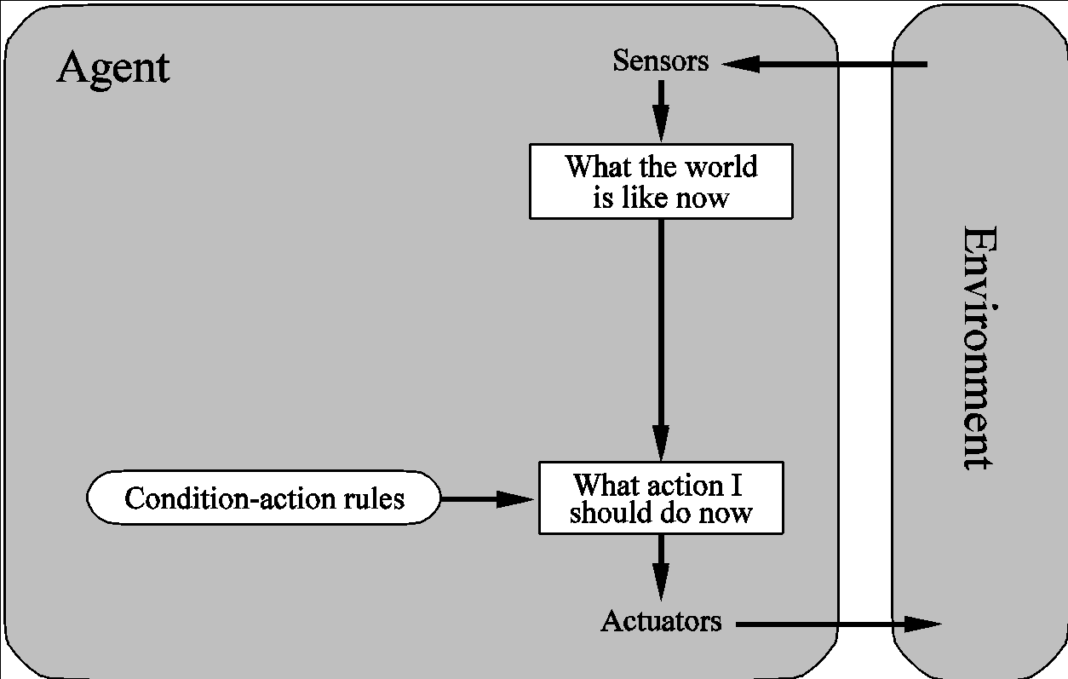
Table-driven/reflex agent architecture
ITC364 Computational Intelligence
‹#›

Slide 11
Table-driven agents
Table lookup of percept-action pairs mapping from every possible perceived state to the optimal action for that state
Problems
Too big to generate and to store (Chess has about 10¹²⁰ states, for example)
No knowledge of non-perceptual parts of the current state
Not adaptive to changes in the environment; requires entire table to be updated if changes occur
Looping: Can’t make actions conditional on previous actions/states

Slide 12
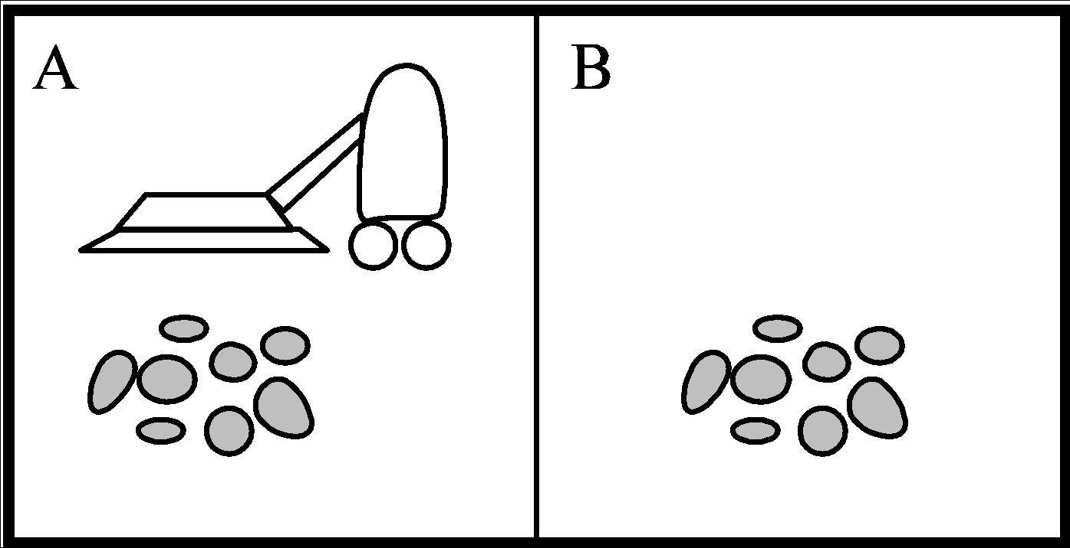
Example: Vacuum Cleaner
ITC364 Computational Intelligence
‹#›

Slide 13
Table/Simple Function
Percept Sequence Action
[A, Clean] Right
[A, Dirty] Suck
[B, Clean] Left
[B, Dirty] Suck
[A, Clean], [A, Clean] Right
[A, Clean], [A, dirty] Suck
…
…
[A, Clean], [A, Clean], [A, Dirty] Suck
ITC364 Computational Intelligence
‹#›

Slide 14
Simple reflex agents
Rule-based reasoning to map from percepts to optimal action; each rule handles a collection of perceived states
Problems
Still usually too big to generate and to store
Still no knowledge of non-perceptual parts of state
Still not adaptive to changes in the environment; requires collection of rules to be updated if changes occur
Still can’t make actions conditional on previous state

Slide 15
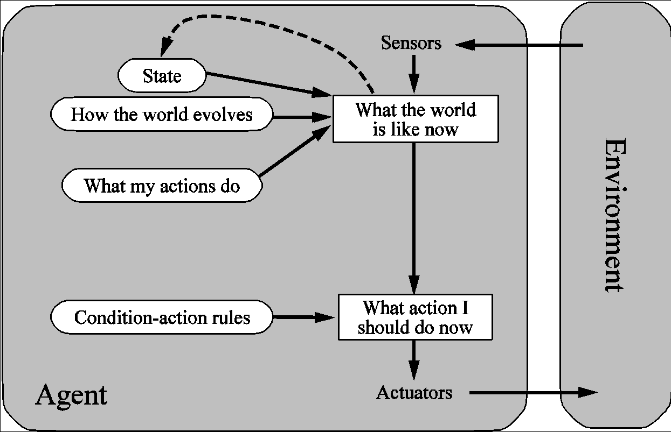
Architecture for a model-based agent
ITC364 Computational Intelligence
‹#›

Slide 16
Model-based Agents
Encode “internal state” of the world to remember the past as contained in earlier percepts.
Needed because sensors do not usually give the entire state of the world at each input, so perception of the environment is captured over time. “State” is used to encode different "world states" that generate the same immediate percept.
Requires ability to represent change in the world; one possibility is to represent just the latest state, but then can’t reason about hypothetical courses of action.

Slide 17
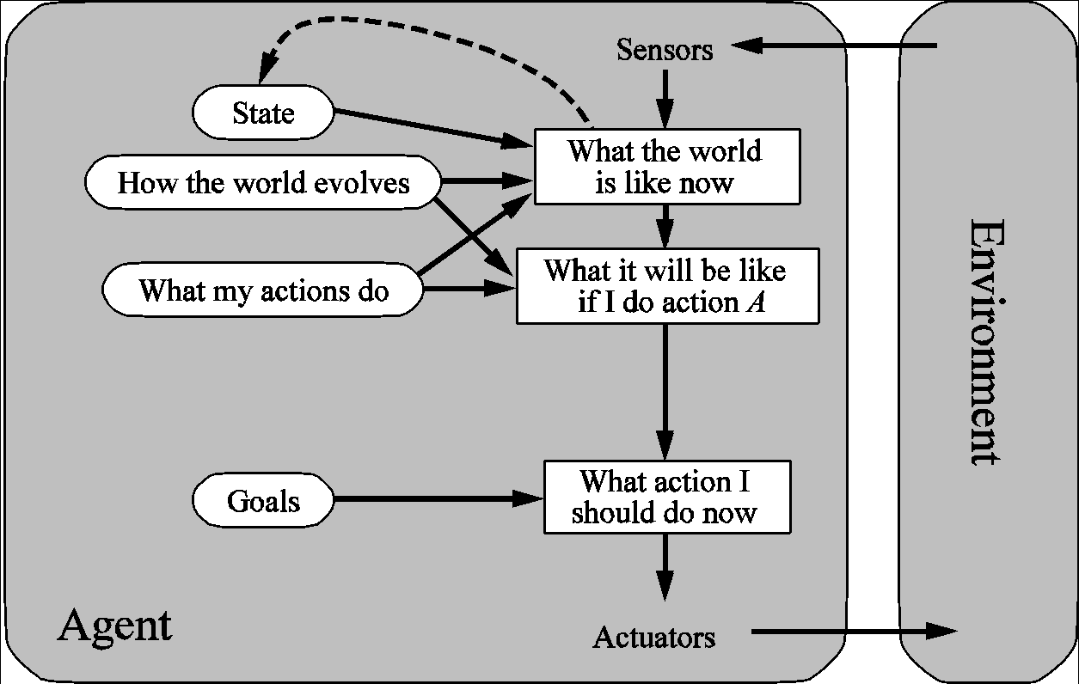
Architecture for goal-based agent
ITC364 Computational Intelligence
‹#›

Slide 18
Goal-based agents
Choose actions so as to achieve a (given or computed) goal.
A goal is a description of a desirable situation.
Keeping track of the current state is often not enough − need to add goals to decide which situations are good
Deliberative instead of reactive.
May have to consider long sequences of possible actions before deciding if goal is achieved – involves consideration of the future, “what will happen if I do...?”

Slide 19
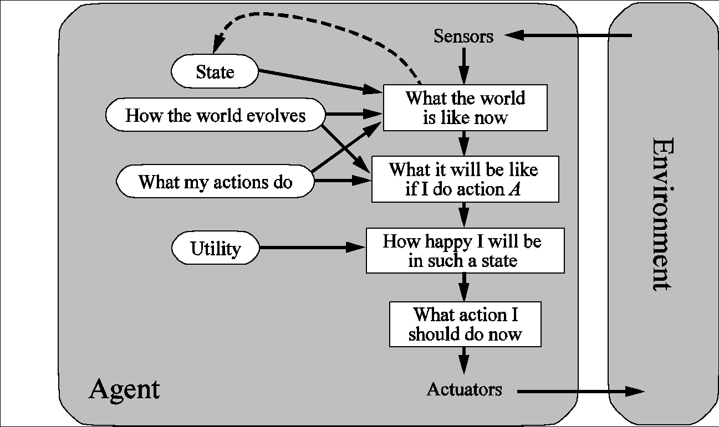
Architecture for a complete utility-based agent
ITC364 Computational Intelligence
‹#›
Notes:
Quality of being useful
‹#›

Slide 20
Utility-based agents
When there are multiple possible alternatives, how to decide which one is best?
A goal specifies a crude distinction between a happy and unhappy state, but often need a more general performance measure that describes “degree of happiness.”
Utility function U: State → Reals indicating a measure of success or happiness when at a given state.
Allows decisions comparing choice between conflicting goals, and choice between likelihood of success and importance of goal (if achievement is uncertain).

Slide 21
Properties of Environments
Fully observable/Partially observable.
If an agent’s sensors give it access to the complete state of the environment needed to choose an action, the environment is fully observable.
Such environments are convenient, since the agent is freed from the task of keeping track of the changes in the environment.
Deterministic/Stochastic.
An environment is deterministic if the next state of the environment is completely determined by the current state of the environment and the action of the agent; in a stochastic environment, there are multiple, unpredictable outcomes
In a fully observable, deterministic environment, the agent need not deal with uncertainty.

Slide 22
Properties of Environments II
Episodic/Sequential.
An episodic environment means that subsequent episodes do not depend on what actions occurred in previous episodes.
In a sequential environment, the agent engages in a series of connected episodes.
Such environments do not require the agent to plan ahead.
Static/Dynamic.
A static environment does not change while the agent is thinking.
The passage of time as an agent deliberates is irrelevant.
The agent doesn’t need to observe the world during deliberation.

Slide 23
Properties of Environments III
Discrete/Continuous.
If the number of distinct percepts and actions is limited, the environment is discrete, otherwise it is continuous.
Single agent/Multi-agent.
If the environment contains other intelligent agents, the agent needs to be concerned about strategic, game-theoretic aspects of the environment (for either cooperative or competitive agents)
Most engineering environments don’t have multi-agent properties, whereas most social and economic systems get their complexity from the interactions of (more or less) rational agents.

Slide 24
Characteristics of environments
 | Fully observable? | Deterministic? | Episodic? | Static? | Discrete? | Single agent?
Crossword
Poker
Taxi driving
Image analysis
Medical diagnosis

Slide 25
Characteristics of environments
 | Fully observable? | Deterministic? | Episodic? | Static? | Discrete? | Single agent?
Crossword | yes | Yes | No | Yes | Yes | Yes
Poker
Taxi driving
Image Analysis
Medical diagnosis

Slide 26
Characteristics of environments
 | Fully observable? | Deterministic? | Episodic? | Static? | Discrete? | Single agent?
Crossword | yes | Yes | No | Yes | Yes | Yes
Poker | No | No | No | Yes | Yes | No
Taxi driving
Image Analysis
Medical diagnosis

Slide 27
Characteristics of environments
 | Fully observable? | Deterministic? | Episodic? | Static? | Discrete? | Single agent?
Crossword | yes | Yes | No | Yes | Yes | Yes
Poker | No | No | No | Yes | Yes | No
Taxi driving | No | No | No | No | No | No
Image Analysis
Medical diagnosis

Slide 28
Characteristics of environments
 | Fully observable? | Deterministic? | Episodic? | Static? | Discrete? | Single agent?
Crossword | yes | Yes | No | Yes | Yes | Yes
Poker | No | No | No | Yes | Yes | No
Taxi driving | No | No | No | No | No | No
Image Analysis | Yes | Yes | Yes | Semi | No | Yes
Medical diagnosis

Slide 29
Characteristics of environments
 | Fully observable? | Deterministic? | Episodic? | Static? | Discrete? | Single agent?
Crossword | yes | Yes | No | Yes | Yes | Yes
Poker | No | No | No | Yes | Yes | No
Taxi driving | No | No | No | No | No | No
Image Analysis | Yes | Yes | Yes | Semi | No | Yes
Medical diagnosis | No | No | No | No | No | Yes
→ Lots of real-world domains fall into the hardest case!

Slide 30
Summary
An agent perceives and acts in an environment, has an architecture, and is implemented by an agent program.
An ideal agent always chooses the action which maximizes its expected performance, given its percept sequence so far.
An autonomous agent uses its own experience rather than built-in knowledge of the environment by the designer.
An agent program maps from percept to action and updates its internal state.
Reflex agents respond immediately to percepts.
Goal-based agents act in order to achieve their goal(s).
Utility-based agents maximize their own utility function.
Representing knowledge is important for successful agent design.
The most challenging environments are partially observable, stochastic, sequential, dynamic, and continuous, and contain multiple intelligent agents.

